Slide 1
KIRUTHIK.P
Final Project
3/21/2024Annual Review
1

Slide 2
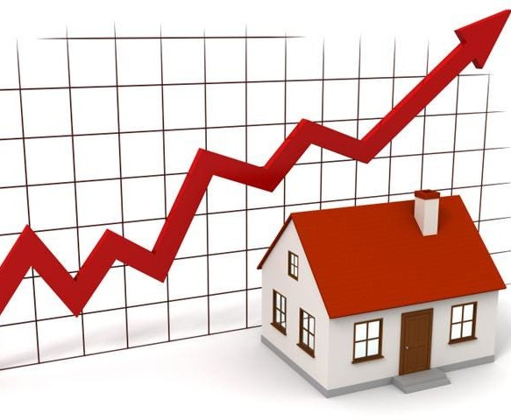
PROJECT TITLE
Estimating House Price in stock market with Random Forest Regression
3/21/2024Annual Review
2

Slide 3

AGENDA
Here's an agenda to guide you through the process of estimating house prices using stock market data with random forest regression:
Understanding the Problem:
Data Collection:
Data Preprocessing:
Feature Engineering:
Model Building:
Model Evaluation:
Interpretation and Visualization: 8.Deployment and Monitoring: 9.Iterative Improvement:
3/21/2024Annual Review
3

Slide 4

PROBLEM STATEMENT
The aim of this project is to develop a predictive model using random forest regression to estimate house prices based on stock market data. The model will utilize historical data on stock market performance along with other relevant features such as house characteristics, location, and economic indicators to predict the selling price of residential properties accurately.
3/21/2024Annual Review

Slide 5

PROJECT OVERVIEW
An overview of the project's objective: to develop a predictive model using random forest regression to estimate house prices based on stock market data.
Described the datasets used in the project, including historical stock market data, house characteristics,
location data, and any other relevant features.
Conduct exploratory data analysis to understand the distributions, correlations, and relationships between different features.
Build a random forest regression model to predict house prices using the engineered features.
Interpret the trained model to understand the importance of different features in predicting house prices.
3/21/2024Annual Review

Slide 6
WHO ARE THE END USERS?
Real Estate Professionals:
Real estate agents, brokers, and agencies could use the model to provide more accurate pricing guidance to their
clients.
Homebuyers and Sellers:
Prospective homebuyers could use the model to assess whether a listed property is priced reasonably based on historical market trends.
Investors:
Real estate investors could use the model to evaluate potential investment opportunities and make informed decis about buying or selling properties.
Financial Institutions:
Mortgage lenders and banks could use the model to assess the risk associated with issuing home loans and determine appropriate loan amounts.
Government and Policy Makers:
Urban planners and policymakers could use the model to analyze housing market trends and make informed decisions about housing policies and urban development initiatives.
3/21/2024Annual Review

Slide 7

YOUR SOLUTION AND ITS VALUE PROPOSITION
By leveraging a random forest regression model, which is capable of capturing complex relationships in the data, the solution provides accurate and precise estimates of house prices.
By integrating stock market data with other relevant features such as house characteristics and economic indicators, the solution offers a comprehensive approach to estimating house prices.
The model can be trained on historical data but applied to real-time or near-real-time stock market data, providing users with timely insights into current market conditions. The solution can be implemented as a user-friendly application or platform that allows users to easily input relevant data and obtain estimated house prices.The random forest regression model provides transparency and interpretability by offering insights into the importance of different features in predicting house prices.
.
3/21/2024Annual Review

Slide 8

THE WOW IN YOUR SOLUTION
The "wow" factor in the solution of estimating house prices using stock market data with random forest regression lies in its ability to seamlessly integrate two seemingly unrelated domains—real estate and stock market—and extract valuable insights from their interactions. Here are some aspects that contribute to the "wow" factor:
Cross-Domain Integration:
Predictive Power:
Timeliness and Relevance:
Accessibility and Usability:
Transparency and Interpretability:
Scalability and Adaptability:
In summary, the "wow" factor in estimating house prices using stock market data with random forest regression lies in its ability to unlock hidden insights, deliver accurate predictions, and empower users to make smarter, data-driven decisions in the dynamic and interconnected worlds of real estate and finances
3/21/2024Annual Review
8

Slide 9
MODELLING
Data Preparation:
Gather relevant datasets containing historical stock market data, house characteristics, location data, and other relevant features.
Feature Engineering:
Select and engineer relevant features that are likely to influence house prices, including stock market data, house characteristics, economic indicators, and location-based features.
Model Selection:
Choose a random forest regression model as the modeling technique, given its ability to capture complex relationships in the data and handle both numerical and categorical features effectivel
Model Training:
Split the preprocessed data into training and testing sets to evaluate the model's performance.
Model Evaluation:
Evaluate the trained model's performance using appropriate evaluation metrics, such as mean squared error (MSE), root mean squared error (RMSE), or R-squared
Model Deployment:
Deploy the trained model into production if applicable, ensuring proper documentation and monitoring of its performance over time.
3/21/2024Annual Review
9

Slide 10
RESULTS
Demo Link
3/21/2024Annual Review
10

